Slide 1

Team Name :Team RO-KO_07
Team Leader Name :Lova Mahesh Siriki
Problem Statement : AI for Healthcare & Life Sciences

Slide 2

Brief about the Idea:
AyuSense AI is a voice-first, Bharat-focused healthcare intelligence system designed to bridge the communication and efficiency gap in India’s healthcare ecosystem. The solution enables patients to describe their symptoms naturally in Indian regional languages, which are then processed using AI to extract clinically relevant information such as symptoms, duration, and severity. AyuSense AI automatically converts these conversations into structured clinical summaries and risk indicators, helping doctors make faster and more informed decisions. By reducing manual documentation and language barriers, the solution improves healthcare delivery efficiency, especially in rural and semi-urban settings, making quality healthcare more accessible and inclusive across Bharat.

Slide 3
Your solution should be able to explain the following:
How different is it from any of the other existing ideas?
Voice-first, multilingual, Bharat-focused healthcare AI.
How will it be able to solve the problem?
Converts patient voice into instant clinical summaries.
USP of the proposed solution
Low-cost, scalable AI for rural healthcare efficiency.

Slide 4
List of features offered by the solution
Voice-based symptom input
Support for Indian regional languages
AI-powered symptom & risk analysis
Auto-generated clinical summaries
Doctor-friendly dashboard
Secure cloud-based patient records

Slide 5
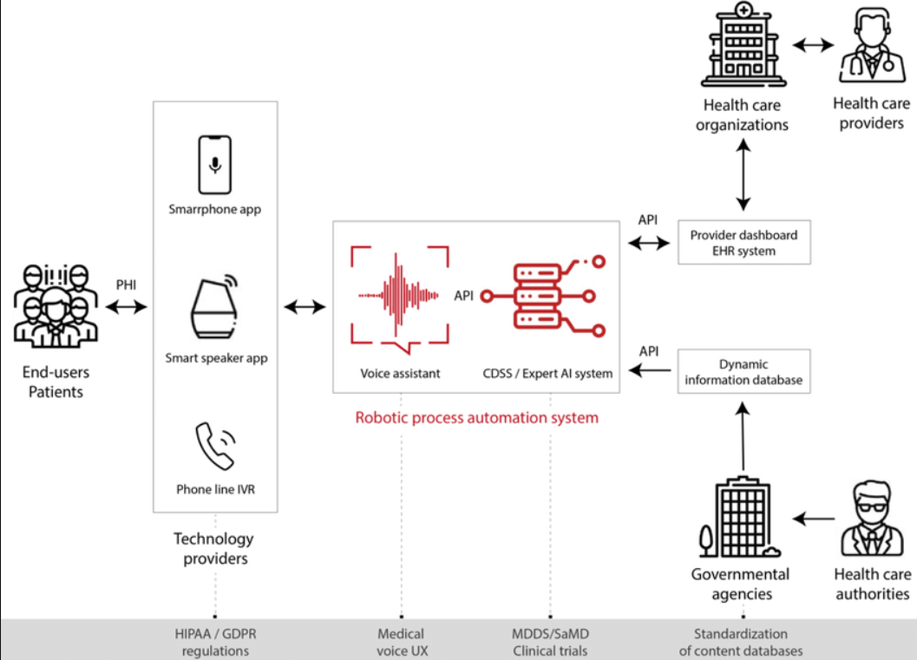
Process flow diagram or Use-case diagram

Slide 6
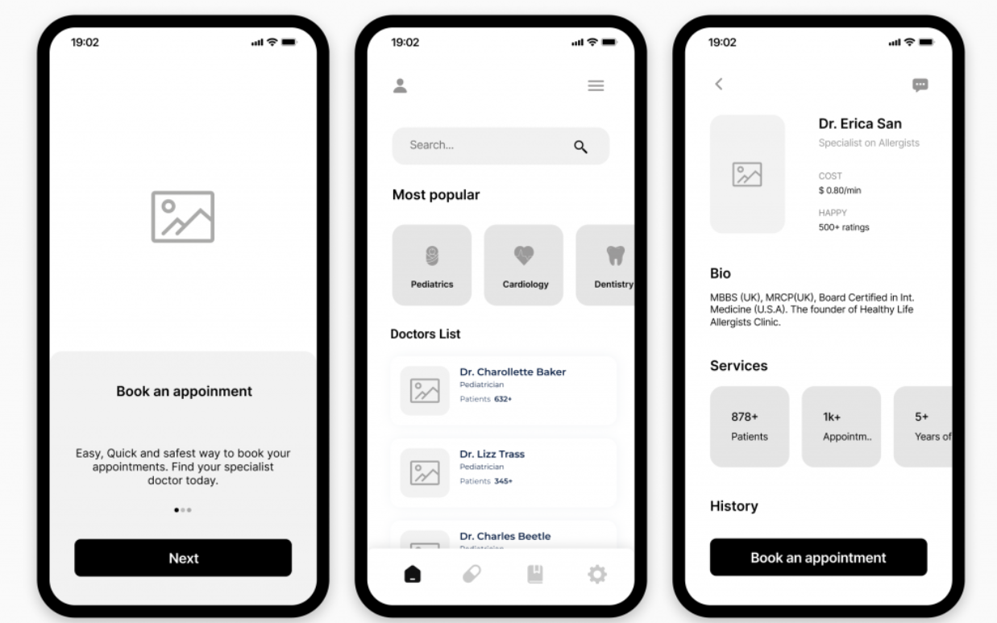
Wireframes/Mock diagrams of the proposed solution (optional)

Slide 7
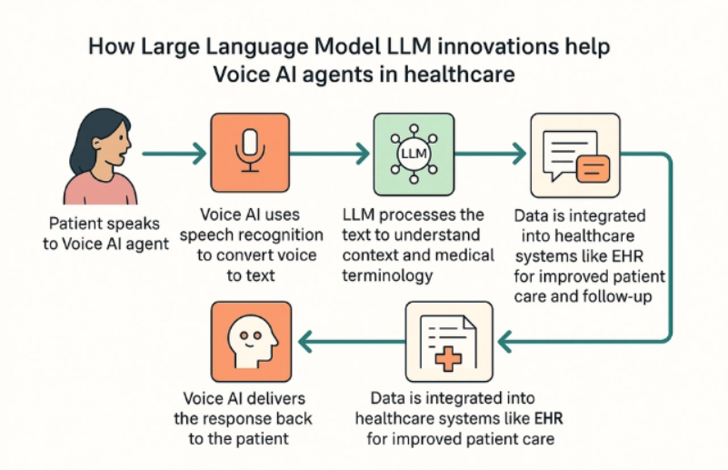
Architecture diagram of the proposed solution:

Slide 8
Technologies to be used in the solution:
AWS Transcribe – Multilingual speech-to-text processing
AWS Comprehend Medical – Clinical NLP and entity extraction
AWS Bedrock (Foundation Models) – Advanced medical reasoning & summarization
AWS Lambda – Serverless business logic execution
Amazon DynamoDB – Secure patient clinical data storage
Amazon S3 – Audio and medical document storage
AWS API Gateway – Secure API communication
Amazon Cognito – User authentication and access control
React / Flutter – Web and mobile application frontend

Slide 9
Estimated implementation cost (optional):
Serverless, pay-per-use architecture
No upfront infrastructure cost
Approximate cost: ₹2–5 per patient interaction
Cost scales efficiently with usage
Affordable for government hospitals and PHCs

Slide 10
Add as per the requirements for the hackathon:
AyuSense AI is designed in alignment with the AI for Bharat Hackathon vision by focusing on inclusive, scalable, and impact-driven healthcare innovation. The solution leverages cloud-based artificial intelligence to address real-world challenges in India’s healthcare ecosystem, particularly in rural and semi-urban regions. It emphasizes accessibility, affordability, and ease of adoption while ensuring secure handling of medical data. The proposed system is practical, future-ready, and suitable for large-scale deployment, supporting national digital healthcare initiatives and improving overall healthcare delivery efficiency across Bharat.

Slide 11


